Slide 1
Programación orientada a Objetos
Generalidades de Java

Slide 2
Conceptos de memoria
Variables
  Toda variable tiene nombre, tipo, tamaño y valor
    El nombre se asocia a una ubicación en memoria
  Cuando un nuevo valor se carga en una variable, reemplaza (destruye) el valor anterior
  Leer el valor de una variable no altera dicho valor

Slide 3
Conceptos de memoria
Representación Visual
  Sum = 0; number1 = 1; number2 = 2;
  Sum = number1 + number2; luego de ejecutar la suma
sum
0
sum
3

Slide 4
Tipos primitivos de datos
Tipos primitivos
  “Bloques básicos” para crear tipos más complicados
Java es fuertemente tipeado
  Toda variable en Java debe tener un tipo
Tipos primitivos en Java
  Son portables entre las diferentes plataformas soportadas por Java

Slide 5
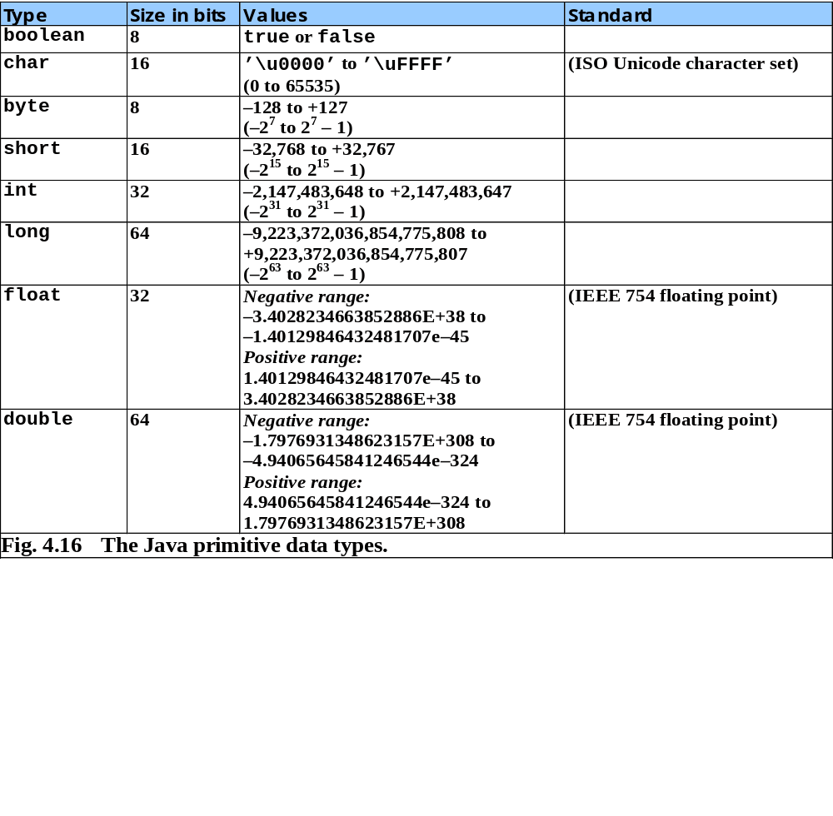

Slide 6
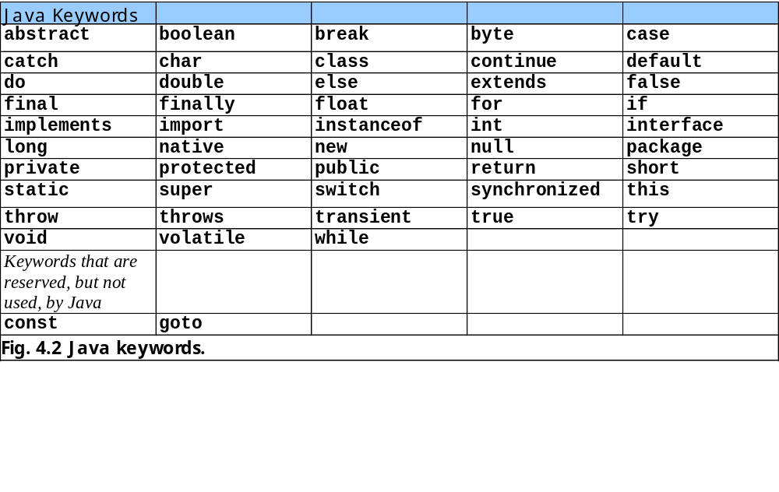
No se pueden usar estas palabras para nombrar variables (ni
Clases ni nada) en Java

Slide 7
Aritmética
Operaciones básicas
  Usar:
    * para multiplicación
    / para división
    +, -
    No hay operador para exponenciación
  División entera trunca el resultado
    7 / 5 es 1
  Operador módulo % returna el residuo
    7 % 5 es 2

Slide 8
Aritmética
Precedencia de operadores
  Algunos operadores actúan antes que otros (ej. * antes de +)
    Usar paréntesis para evitar confusiones
  Ej.: promediar a, b, c
    No usar: a + b + c / 3
    Usar: (a + b + c ) / 3
  Orden PEMDAS
    Paréntesis, Exponentes, Multiplicación, División, Adición, Subtracción

Slide 9
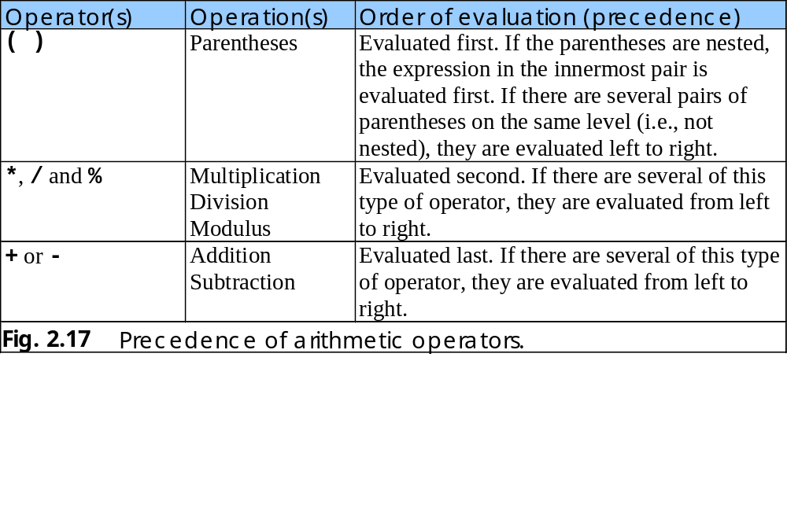
Aritmética

Slide 10
Igualdad y operadores relacionales
Estructura de control if
  Si la condición es true, se ejecuta el cuerpo del if
    0 es false, no-cero es true
  El control prosigue luego del cuerpo del if
  Las condiciones del if usan igualdad y/o operadores relacioanles
  if ( condición )
  Ejecutar cuerpo si condición es true
    No usar punto y coma en la línea del if

Slide 11
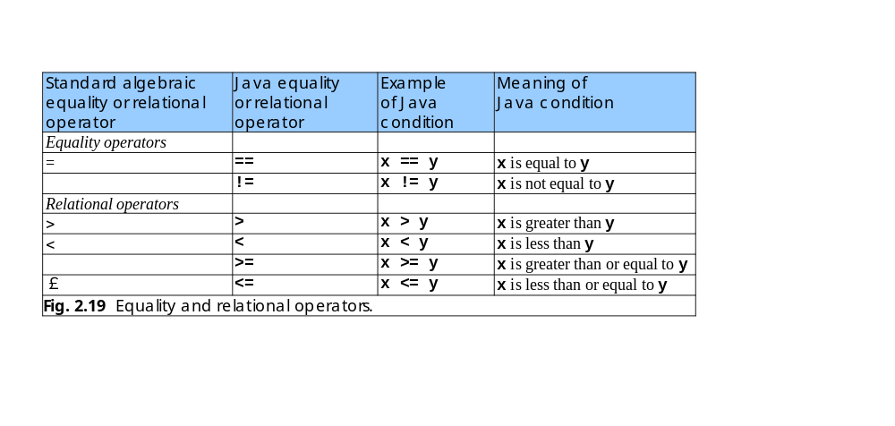
Igualdad y operadores relacionales

Slide 12
Comparison.java
1. import
2. Class Comparison
2.1 main
2.2 Declarations
2.3 Input data (showInputDialog)
2.4 parseInt
2.5 Initialize result
1 // Fig. 2.20: Comparison.java
2 // Compare integers using if structures, relational operators
3 // and equality operators.
4
5 // Java extension packages
6 import javax.swing.JOptionPane;
7
8 public class Comparison {
9
10 // main method begins execution of Java application
11 public static void main( String args[] )
12 {
13 String firstNumber; // first string entered by user
14 String secondNumber; // second string entered by user
15 String result; // a string containing the output
16 int number1; // first number to compare
17 int number2; // second number to compare
18
19 // read first number from user as a string
20 firstNumber =
21 JOptionPane.showInputDialog( "Enter first integer:" );
22
23 // read second number from user as a string
24 secondNumber =
25 JOptionPane.showInputDialog( "Enter second integer:" );
26
27 // convert numbers from type String to type int
28 number1 = Integer.parseInt( firstNumber );
29 number2 = Integer.parseInt( secondNumber );
30
31 // initialize result to empty String
32 result = "";
33

Slide 13
Comparison.java
3. if statements
4. showMessageDialog
34 if ( number1 == number2 )
35 result = number1 + " == " + number2;
36
37 if ( number1 != number2 )
38 result = number1 + " != " + number2;
39
40 if ( number1 < number2 )
41 result = result + "\n" + number1 + " < " + number2;
42
43 if ( number1 > number2 )
44 result = result + "\n" + number1 + " > " + number2;
45
46 if ( number1 <= number2 )
47 result = result + "\n" + number1 + " <= " + number2;
48
49 if ( number1 >= number2 )
50 result = result + "\n" + number1 + " >= " + number2;
51
52 // Display results
53 JOptionPane.showMessageDialog(
54 null, result, "Comparison Results",
55 JOptionPane.INFORMATION_MESSAGE );
56
57 System.exit( 0 ); // terminate application
58
59 } // end method main
60
61 } // end class Comparison
Test for equality, create new string, assign to result.
Notice use of JOptionPane.INFORMATION_MESSAGE

Slide 14
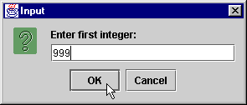
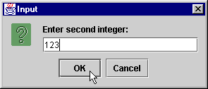
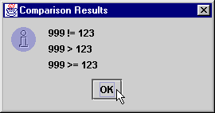
Program Output

Slide 15
Igualdad y operadores relacionales
  Lineas 1-12: Comenariosts, import JOptionPane, inicio de las clases Comparison y main
  Lineas 13-17: declara variables
    Lista de variables eparadas por coma:
  Lineas 20-29: obtener números como String y los convierte a integer
13 String firstNumber,
14 secondNumber,
15 result;

Slide 16
Igualdad y operadores relacionales
  Initializa result como texto vacio
  if testea una igualdad (==)
    Si las variables son iguales (condición true)
      result concatena usando operador +
      result = result + otro string
      Reemplaza viejo result
    Si no son iguales, no hacen nada
32 result = "";
34 if ( number1 == number2 )
35 result = number1 + " == " + number2;

Slide 17
Igualdad y operadores relacionales
  Lineas 37-50: otros if testean operadores varios.
    If number1 = 123 and number2 = 123
      Linea 34 evalua a true (if number1 = = number 2)
        Porque number1 es igual a number2
      Linea 40 evalua a false (if number1 < number 2)
        Porque number1 no es menor que number2
      Linea 49 evalua a true (if number1 >= number2)
        Porque number1 es mayor o igual a number2
  Lines 50-52: result displayado en un dialog box usando showMessageDialog

Slide 18
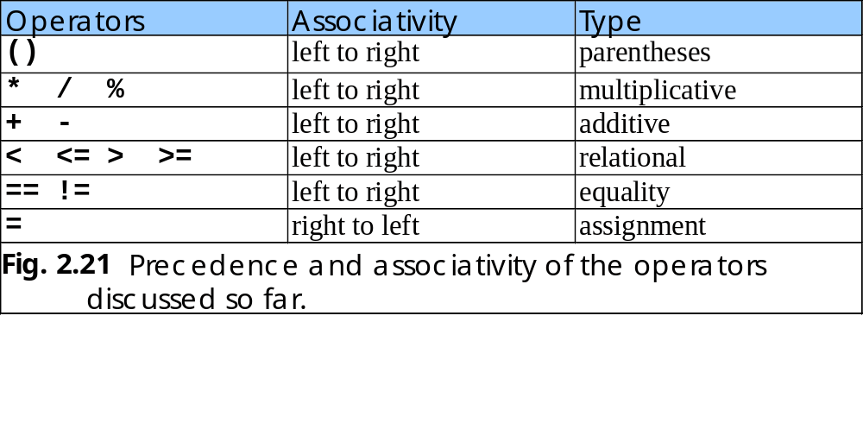
Igualdad y operadores relacionales
Precedencia de operadores
  Todos excepto asignación (=) se evaluán de izquierda a derecha
    Ej: x = y = z se evalua como x = (y = z)

Slide 19
Estructuras de control
Ejecución secuencial
  Las operaciones se ejecutan de una línea a la siguiente
Transferencia de control
    Estructura secuencial
    Estructura de selección
    Estructura de repetición
Flowchart / diagrama de flujo
  Representación gráfica de un algoritmo
    Indican el orden de ejecución de las acciones

Slide 20
Líneas de flujo
Símbolos de acción
add grade to total
total = total + grade;
add 1 to counter
counter = counter +
1
;
Conectores
    Fig 4.1 Flowcharting Java’s sequence structure.

Slide 21
Estructuras de selección
La estructura de secuencia es “por defecto”
Java proporciona 3 estructuras de selección
  if
  if/else
  switch
Java proporciona 3 estructuras de repetición
  while
  do/while
  do

Slide 22
Estructuras de selección if
Una única entrada y salida (a lo más se ejecuta una vez)
Se ejecuta si la condición es true

Slide 23
Símbolo de decisión
true
grade >= 60
print “Passed”
false
    Fig 4.3 Flowcharting the single-selection if structure.

Slide 24
Estructura se selección if/else
Ejecuta una acción cuando la condición es true
Ejecuta otra acción diferente si es false
Operador simplificado (?:)
Los if/else se pueden anidar

Slide 25
false
true
grade >= 60
print “Failed”
print “Passed”
    Fig 4.4 Flowcharting the double-selection if/else structure.

Slide 26
Estructura de repetición while
Repite una acción mientras la condición sea true

Slide 27
true
product <= 1000
product = 2 * product
false
    Fig 4.5 Flowcharting the while repetition structure.

Slide 28
Caso de estudio 1 (repetición controlada por contador)
Contador
  Variable que controla el número de veces que un cuerpo se ejecuta
Average1.java calcula promedios
  Usa contadores

Slide 29
Set total to 0
Set grade counter to 1
While grade counter is less than or equal to 10
Input the next grade
Add the grade into the total
Add one to the grade counter
Set the class average to the total divided by 10
Print the class average

Slide 30
Average1.java gradeCounter
Line 23
1 // Fig. 4.7: Average1.java
2 // Class average program with counter-controlled repetition.
3
4 // Java extension packages
5 import javax.swing.JOptionPane;
6
7 public class Average1 {
8
9 // main method begins execution of Java application
10 public static void main( String args[] )
11 {
12 int total, // sum of grades input by user
13 gradeCounter, // number of grades entered
14 gradeValue, // grade value
15 average; // average of all grades
16 String grade; // grade typed by user
17
18 // Initialization Phase
19 total = 0; // clear total
20 gradeCounter = 1; // prepare to loop
21
22 // Processing Phase
23 while ( gradeCounter <= 10 ) { // loop 10 times
24
25 // prompt for input and read grade from user
26 grade = JOptionPane.showInputDialog(
27 "Enter integer grade: " );
28
29 // convert grade from a String to an integer
30 gradeValue = Integer.parseInt( grade );
31
32 // add gradeValue to total
33 total = total + gradeValue;
34
Declare variables; gradeCounter is the counter
Continue looping as long as gradeCounter is less than or equal to 10

Slide 31
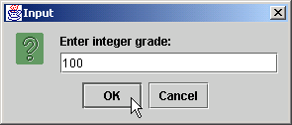
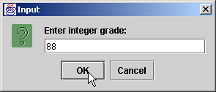
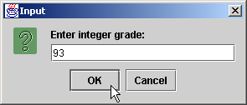

Average1.java
35 // add 1 to gradeCounter
36 gradeCounter = gradeCounter + 1;
37
38 } // end while structure
39
40 // Termination Phase
41 average = total / 10; // perform integer division
42
43 // display average of exam grades
44 JOptionPane.showMessageDialog( null,
45 "Class average is " + average, "Class Average",
46 JOptionPane.INFORMATION_MESSAGE );
47
48 System.exit( 0 ); // terminate the program
49
50 } // end method main
51
52 } // end class Average1

Slide 32
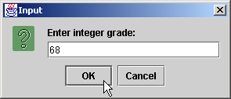
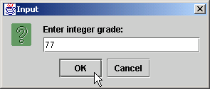


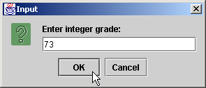

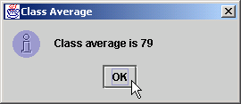
Average1.java

Slide 33
Caso de estudio 2 (repetición controlada por centinela)
Variable centinela
  Usada para indicar que una acción debe parar
Average2.java tiene repetición indefinida
  Usuario entra un valor centinela (-1) para finalizar la repetición

Slide 34
Initialize total to 0
Initialize counter to 0
Input the first grade (possibly the sentinel)
While the user has not as yet entered the sentinel
Add this grade into the running total
Add 1 to the grade counter
Input the next grade (possibly the sentinel)
If the counter is not equal to 0
Set the average = total divided by the counter
Print the average
else
Print “No grades were entered”

Slide 35
Average2.java
1 // Fig. 4.9: Average2.java
2 // Class average program with sentinel-controlled repetition.
3
4 // Java core packages
5 import java.text.DecimalFormat;
6
7 // Java extension packages
8 import javax.swing.JOptionPane;
9
10 public class Average2 {
11
12 // main method begins execution of Java application
13 public static void main( String args[] )
14 {
15 int gradeCounter, // number of grades entered
16 gradeValue, // grade value
17 total; // sum of grades
18 double average; // average of all grades
19 String input; // grade typed by user
20
21 // Initialization phase
22 total = 0; // clear total
23 gradeCounter = 0; // prepare to loop
24
25 // Processing phase
26 // prompt for input and read grade from user
27 input = JOptionPane.showInputDialog(
28 "Enter Integer Grade, -1 to Quit:" );
29
30 // convert grade from a String to an integer
31 gradeValue = Integer.parseInt( input );
32

Slide 36
Average2.java
Line 33
Line 50
33 while ( gradeValue != -1 ) {
34
35 // add gradeValue to total
36 total = total + gradeValue;
37
38 // add 1 to gradeCounter
39 gradeCounter = gradeCounter + 1;
40
41 // prompt for input and read grade from user
42 input = JOptionPane.showInputDialog(
43 "Enter Integer Grade, -1 to Quit:" );
44
45 // convert grade from a String to an integer
46 gradeValue = Integer.parseInt( input );
47 }
48
49 // Termination phase
50 DecimalFormat twoDigits = new DecimalFormat( "0.00" );
51
52 if ( gradeCounter != 0 ) {
53 average = (double) total / gradeCounter;
54
55 // display average of exam grades
56 JOptionPane.showMessageDialog( null,
57 "Class average is " + twoDigits.format( average ),
58 "Class Average", JOptionPane.INFORMATION_MESSAGE );
59 }
60 else
61 JOptionPane.showMessageDialog( null,
62 "No grades were entered", "Class Average",
63 JOptionPane.INFORMATION_MESSAGE );
64
65 System.exit( 0 ); // terminate application
66
loop until gradeCounter equals sentinel value (-1)
Format numbers to nearest hundredth

Slide 37
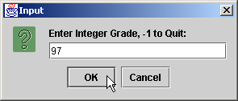
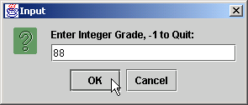

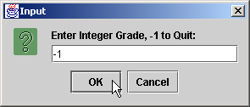
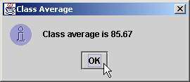
Average2.java
67 } // end method main
68
69 } // end class Average2

Slide 38
Caso de estudio 3
(Estructiras de control anidadas)
Anidado: unas dentro de otras

Slide 39
Initialize passes to 0
Initialize failures to 0
Initialize student to 1
While student counter is less than or equal to 10
Input the next exam result
If the student passed
Add 1 to passes
else
Add 1 to failures
Add 1 to student counter
Print the number of passes
Print the number of failures
If more than 8 students passed
Print “Raise tuition”

Slide 40
Analysis.java
Line 21
Line 31
1 // Fig. 4.11: Analysis.java
2 // Analysis of examination results.
3
4 // Java extension packages
5 import javax.swing.JOptionPane;
6
7 public class Analysis {
8
9 // main method begins execution of Java application
10 public static void main( String args[] )
11 {
12 // initializing variables in declarations
13 int passes = 0, // number of passes
14 failures = 0, // number of failures
15 student = 1, // student counter
16 result; // one exam result
17 String input, // user-entered value
18 output; // output string
19
20 // process 10 students; counter-controlled loop
21 while ( student <= 10 ) {
22
23 // obtain result from user
24 input = JOptionPane.showInputDialog(
25 "Enter result (1=pass,2=fail)" );
26
27 // convert result to int
28 result = Integer.parseInt( input );
29
30 // process result
31 if ( result == 1 )
32 passes = passes + 1;
33 else
34 failures = failures + 1;
Loop until student counter is greater than 10
Nested control structure

Slide 41
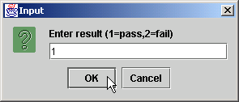
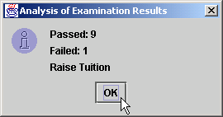
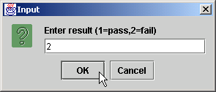
Analysis.java
35
36 student = student + 1;
37 }
38
39 // termination phase
40 output = "Passed: " + passes +
41 "\nFailed: " + failures;
42
43 if ( passes > 8 )
44 output = output + "\nRaise Tuition";
45
46 JOptionPane.showMessageDialog( null, output,
47 "Analysis of Examination Results",
48 JOptionPane.INFORMATION_MESSAGE );
49
50 System.exit( 0 ); // terminate application
51
52 } // end method main
53
54 } // end class Analysis

Slide 42
Operadores de asignación
Uso
  Asignar valor a una variable de forma “express”
  De la forma
    variable = variable operador expresión;
  Se pueden resumor como
    variable operador= expression;
  Ej.: operador +=
    c = c + 3
  se resume como
    c += 3

Slide 43
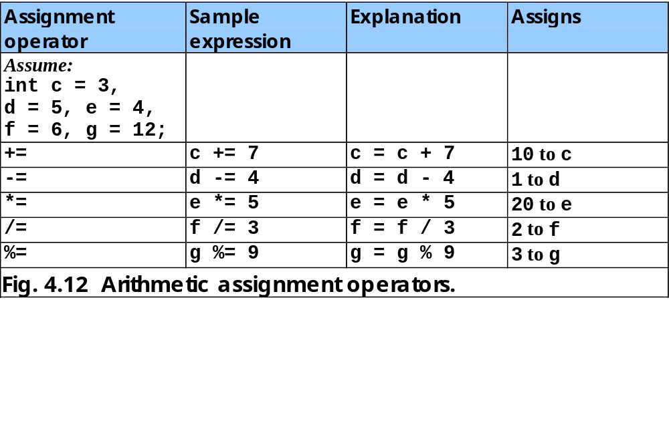

Slide 44
Operadores increemento y decremento
Operador (++)
  Incrementa el valor de la variable en 1
Operador (--)
  Decrementa el valor de la variable en 1
Pueden ser pre y post

Slide 45
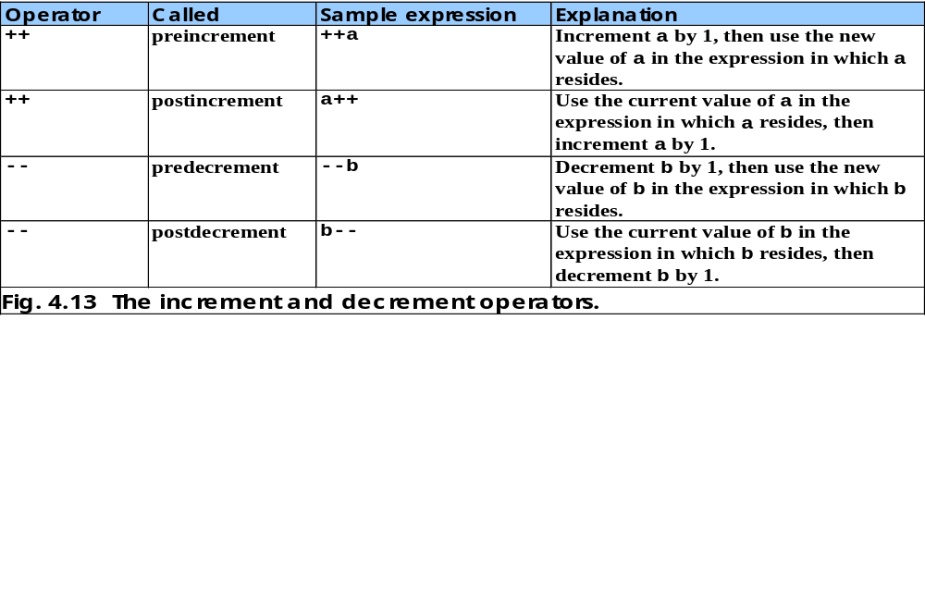

Slide 46
Increment.java
Line 13 postincrement
Line 20 preincrement
1 // Fig. 4.14: Increment.java
2 // Preincrementing and postincrementing
3
4 public class Increment {
5
6 // main method begins execution of Java application
7 public static void main( String args[] )
8 {
9 int c;
10
11 c = 5;
12 System.out.println( c ); // print 5
13 System.out.println( c++ ); // print 5 then postincrement
14 System.out.println( c ); // print 6
15
16 System.out.println(); // skip a line
17
18 c = 5;
19 System.out.println( c ); // print 5
20 System.out.println( ++c ); // preincrement then print 6
21 System.out.println( c ); // print 6
22
23 } // end method main
24
25 } // end class Increment
Line 13 postincrements c
Line 20 preincrements c
5
5
6
5
6
6

Slide 47
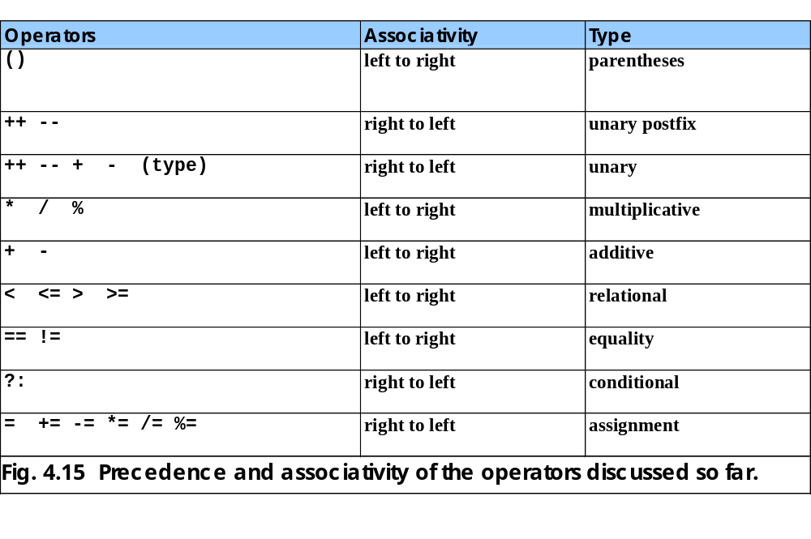

Slide 48
Repetición controlada por contador
Se necesita:
  Nombre de variable de control (contador del loop)
  Su valo inicial
  Incremento/decremento de la variable en cada loop
  Condición que chequea si se llegó al valor final de la variable para detener la repetición

Slide 49
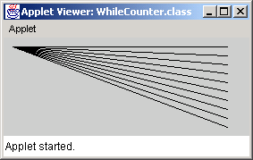
WhileCounter.java
Line 18
Line 20
Line 22
1 // Fig. 5.1: WhileCounter.java
2 // Counter-controlled repetition
3
4 // Java core packages
5 import java.awt.Graphics;
6
7 // Java extension packages
8 import javax.swing.JApplet;
9
10 public class WhileCounter extends JApplet {
11
12 // draw lines on applet’s background
13 public void paint( Graphics g )
14 {
15 // call inherited version of method paint
16 super.paint( g );
17
18 int counter = 1; // initialization
19
20 while ( counter <= 10 ) { // repetition condition
21 g.drawLine( 10, 10, 250, counter * 10 );
22 ++counter; // increment
23
24 } // end while structure
25
26 } // end method paint
27
28 } // end class WhileCounter
Control-variable name is counter
Control-variable initial value is 1
Condition tests for counter’s final value
Increment for counter

Slide 50
Estructura de repetición for
Maneja repeticiones por contador en forma más resumida que un while

Slide 51
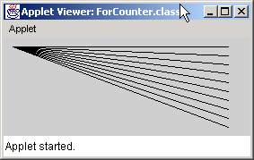
ForCounter.java
Line 20 int counter = 1;
Line 20 counter <= 10;
Line 20 counter++;
1 // Fig. 5.2: ForCounter.java
2 // Counter-controlled repetition with the for structure
3
4 // Java core packages
5 import java.awt.Graphics;
6
7 // Java extension packages
8 import javax.swing.JApplet;
9
10 public class ForCounter extends JApplet {
11
12 // draw lines on applet’s background
13 public void paint( Graphics g )
14 {
15 // call inherited version of method paint
16 super.paint( g );
17
18 // Initialization, repetition condition and incrementing
19 // are all included in the for structure header.
20 for ( int counter = 1; counter <= 10; counter++ )
21 g.drawLine( 10, 10, 250, counter * 10 );
22
23 } // end method paint
24
25 } // end class ForCounter
Control-variable name is counter
Control-variable initial value is 1
Condition tests for counter’s final value
Increment for counter

Slide 52
Line 20
for
Nombre de variable
Valor final
keyword
de control
de variable de control
for (
int
counter =
1
; counter <=
10
; counter++ )
Valor inicial
Incremento
de variable de control
de variable de control
Condición para continuar el loop

Slide 53
Estructura de repetición for
for ( expression1; expression2; expression3 )
statement;
Equivale a:
expression1;
while ( expression2 ) {
statement;
expression3;
}

Slide 54
Establish
int counter = 1
initial value
of control variable.
Determine if
true
g.drawLine(
final value
counter <= 10
10, 10, 250,
counter++
of control
counter * 10
Increment
variable has been
);
the control
reached.
false
Body of loop
variable.
(this may be many
statements)
Fig. 5.4 Flowcharting a typical for repetition structure.

Slide 55
Ejemplos con for
El for es versatil
  De 1 a 100 en incrementos de 1
    for ( int i = 1; i <= 100; i++ )
  De 100 a 1 en decrementos de –1
    for ( int i = 100; i >= 1; i-- )
  Saltando 7 a la vez
    for ( int i = 7; i <= 77; i += 7 )

Slide 56
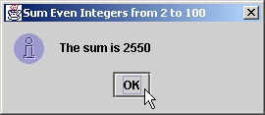
Sum.java
Line 15
1 // Fig. 5.5: Sum.java
2 // Counter-controlled repetition with the for structure
3
4 // Java extension packages
5 import javax.swing.JOptionPane;
6
7 public class Sum {
8
9 // main method begins execution of Java application
10 public static void main( String args[] )
11 {
12 int sum = 0;
13
14 // sum even integers from 2 through 100
15 for ( int number = 2; number <= 100; number += 2 )
16 sum += number;
17
18 // display results
19 JOptionPane.showMessageDialog( null, "The sum is " + sum,
20 "Sum Even Integers from 2 to 100",
21 JOptionPane.INFORMATION_MESSAGE );
22
23 System.exit( 0 ); // terminate the application
24
25 } // end method main
26
27 } // end class Sum
increment number by 2 each iteration

Slide 57
Interest.java
Line 17
Line 21
Line 22
Lines 31-34
1 // Fig. 5.6: Interest.java
2 // Calculating compound interest
3
4 // Java core packages
5 import java.text.NumberFormat;
6 import java.util.Locale;
7
8 // Java extension packages
9 import javax.swing.JOptionPane;
10 import javax.swing.JTextArea;
11
12 public class Interest {
13
14 // main method begins execution of Java application
15 public static void main( String args[] )
16 {
17 double amount, principal = 1000.0, rate = 0.05;
18
19 // create DecimalFormat to format floating-point numbers
20 // with two digits to the right of the decimal point
21 NumberFormat moneyFormat =
22 NumberFormat.getCurrencyInstance( Locale.US );
23
24 // create JTextArea to display output
25 JTextArea outputTextArea = new JTextArea();
26
27 // set first line of text in outputTextArea
28 outputTextArea.setText( "Year\tAmount on deposit\n" );
29
30 // calculate amount on deposit for each of ten years
31 for ( int year = 1; year <= 10; year++ ) {
32
33 // calculate new amount for specified year
34 amount = principal * Math.pow( 1.0 + rate, year );
35
Java treats floating-points as type double
NumberFormat can format numeric values as currency
Display currency values with dollar sign ($)
Calculate amount with for structure

Slide 58
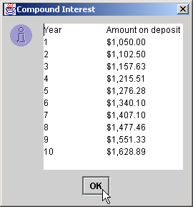
Interest.java
36 // append one line of text to outputTextArea
37 outputTextArea.append( year + "\t" +
38 moneyFormat.format( amount ) + "\n" );
39
40 } // end for structure
41
42 // display results
43 JOptionPane.showMessageDialog( null, outputTextArea,
44 "Compound Interest", JOptionPane.INFORMATION_MESSAGE );
45
46 System.exit( 0 ); // terminate the application
47
48 } // end method main
49
50 } // end class Interest

Slide 59
Selección múltiple con switch
switch remplaza a varios if
  Si los if son MUTUAMENTE EXCLUYENTES

Slide 60
SwitchTest.java
Lines 19-25:
Getting user’s input
1 // Fig. 5.7: SwitchTest.java
2 // Drawing lines, rectangles or ovals based on user input.
3
4 // Java core packages
5 import java.awt.Graphics;
6
7 // Java extension packages
8 import javax.swing.*;
9
10 public class SwitchTest extends JApplet {
11 int choice; // user's choice of which shape to draw
12
13 // initialize applet by obtaining user's choice
14 public void init()
15 {
16 String input; // user's input
17
18 // obtain user’s choice
19 input = JOptionPane.showInputDialog(
20 "Enter 1 to draw lines\n" +
21 "Enter 2 to draw rectangles\n" +
22 "Enter 3 to draw ovals\n");
23
24 // convert user's input to an int
25 choice = Integer.parseInt( input );
26 }
27
28 // draw shapes on applet's background
29 public void paint( Graphics g )
30 {
31 // call inherited version of method paint
32 super.paint( g );
33
Get user’s input in JApplet

Slide 61
SwitchTest.java
Line 38: controlling expression
Line 38: switch structure
Line 54
34 // loop 10 times, counting from 0 through 9
35 for ( int i = 0; i < 10; i++ ) {
36
37 // determine shape to draw based on user's choice
38 switch ( choice ) {
39
40 case 1:
41 g.drawLine( 10, 10, 250, 10 + i * 10 );
42 break; // done processing case
43
44 case 2:
45 g.drawRect( 10 + i * 10, 10 + i * 10,
46 50 + i * 10, 50 + i * 10 );
47 break; // done processing case
48
49 case 3:
50 g.drawOval( 10 + i * 10, 10 + i * 10,
51 50 + i * 10, 50 + i * 10 );
52 break; // done processing case
53
54 default:
55 g.drawString( "Invalid value entered",
56 10, 20 + i * 15 );
57
58 } // end switch structure
59
60 } // end for structure
61
62 } // end paint method
63
64 } // end class SwitchTest
user input (choice) is controlling expression
switch structure determines which case label to execute, depending on controlling expression
default case for invalid entries

Slide 62
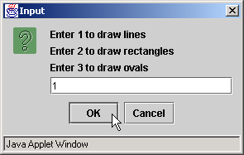

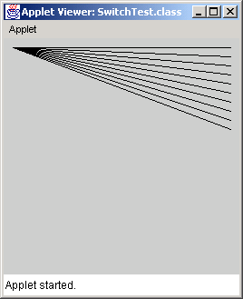
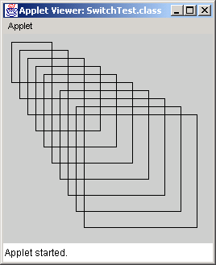
SwitchTest.java

Slide 63

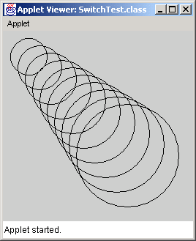
SwitchTest.java

Slide 64
true
case a
case a action(s)
break
false
true
case b
case b action(s)
break
false
true
case z
case z action(s)
break
false
default action(s)
Fig. 5.8 The switch multiple-selection structure.

Slide 65
Estructura de repetición do/while
do/while
  Parecido al while
  Pero chequea la condición DESPUES del cuerpo
    O sea, el cuerpo del loop se ejecuta siempre por lo menos una vez

Slide 66
DoWhileTest.java
Lines 20-24
1 // Fig. 5.9: DoWhileTest.java
2 // Using the do/while repetition structure.
3
4 // Java core packages
5 import java.awt.Graphics;
6
7 // Java extension packages
8 import javax.swing.JApplet;
9
10 public class DoWhileTest extends JApplet {
11
12 // draw lines on applet’s background
13 public void paint( Graphics g )
14 {
15 // call inherited version of method paint
16 super.paint( g );
17
18 int counter = 1;
19
20 do {
21 g.drawOval( 110 - counter * 10, 110 - counter * 10,
22 counter * 20, counter * 20 );
23 ++counter;
24 } while ( counter <= 10 ); // end do/while structure
25
26 } // end method paint
27
28 } // end class DoWhileTest
Oval is drawn before testing counter’s final value

Slide 67
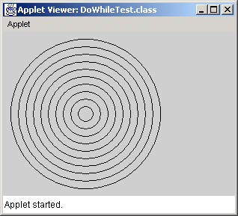
DoWhileTest.java

Slide 68
action(s)
true
condition
false
Fig. 5.10 Flowcharting the do/while repetition structure.

Slide 69
break y continue
break/continue
  Alteran flujo de control
break
  Causa la salida inmediata de la estructura de control
    Aplica al while, for, do/while o switch
continue
  Se salta lo que queda del loop pero sin salir de la repetición
  Prosigu a la siguiente iteración del loop
    Utilizable en while, for o do/while

Slide 70
BreakTest.java
Line 16
Lines 19-20
1 // Fig. 5.11: BreakTest.java
2 // Using the break statement in a for structure
3
4 // Java extension packages
5 import javax.swing.JOptionPane;
6
7 public class BreakTest {
8
9 // main method begins execution of Java application
10 public static void main( String args[] )
11 {
12 String output = "";
13 int count;
14
15 // loop 10 times
16 for ( count = 1; count <= 10; count++ ) {
17
18 // if count is 5, terminate loop
19 if ( count == 5 )
20 break; // break loop only if count == 5
21
22 output += count + " ";
23
24 } // end for structure
25
26 output += "\nBroke out of loop at count = " + count;
27 JOptionPane.showMessageDialog( null, output );
28
29 System.exit( 0 ); // terminate application
30
31 } // end method main
32
33 } // end class BreakTest
Loop 10 times
exit for structure (break) when count equals 5

Slide 71
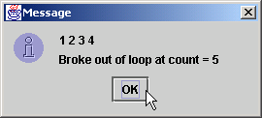
BreakTest.java

Slide 72
ContinueTest.java
Line 15
Lines 18-19
1 // Fig. 5.12: ContinueTest.java
2 // Using the continue statement in a for structure
3
4 // Java extension packages
5 import javax.swing.JOptionPane;
6
7 public class ContinueTest {
8
9 // main method begins execution of Java application
10 public static void main( String args[] )
11 {
12 String output = "";
13
14 // loop 10 times
15 for ( int count = 1; count <= 10; count++ ) {
16
17 // if count is 5, continue with next iteration of loop
18 if ( count == 5 )
19 continue; // skip remaining code in loop
20 // only if count == 5
21
22 output += count + " ";
23
24 } // end for structure
25
26 output += "\nUsed continue to skip printing 5";
27 JOptionPane.showMessageDialog( null, output );
28
29 System.exit( 0 ); // terminate application
30
31 } // end method main
32
33 } // end class ContinueTest
Loop 10 times
Skip line 22 and proceed to line 15 when count equals 5

Slide 73
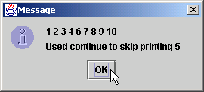
ContinueTest.java

Slide 74
break y continue con etiquetas
Bloque etiquetado
  Bloque definido con {}
  Precedido por una etiqueta
break etiquetado
  Finaliza la estructura asociada al bloque de la misma etiqueta
continue etiquetado es análogo

Slide 75
BreakLabelTest.java
Line 14
Line 17
Line 20
Lines 23-24
1 // Fig. 5.13: BreakLabelTest.java
2 // Using the break statement with a label
3
4 // Java extension packages
5 import javax.swing.JOptionPane;
6
7 public class BreakLabelTest {
8
9 // main method begins execution of Java application
10 public static void main( String args[] )
11 {
12 String output = "";
13
14 stop: { // labeled block
15
16 // count 10 rows
17 for ( int row = 1; row <= 10; row++ ) {
18
19 // count 5 columns
20 for ( int column = 1; column <= 5 ; column++ ) {
21
22 // if row is 5, jump to end of "stop" block
23 if ( row == 5 )
24 break stop; // jump to end of stop block
25
26 output += "* ";
27
28 } // end inner for structure
29
30 output += "\n";
31
32 } // end outer for structure
33
34 // the following line is skipped
35 output += "\nLoops terminated normally";
stop is the labeled block
Loop 10 times
Nested loop 5 times
Exit to line 37 (next slide)

Slide 76
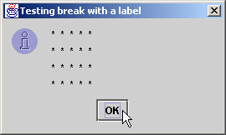
BreakLabelTest.java
36
37 } // end labeled block
38
39 JOptionPane.showMessageDialog(
40 null, output,"Testing break with a label",
41 JOptionPane.INFORMATION_MESSAGE );
42
43 System.exit( 0 ); // terminate application
44
45 } // end method main
46
47 } // end class BreakLabelTest

Slide 77
ContinueLabelTest.java
Line 14
Line 17
Line 21
Lines 24-25
1 // Fig. 5.14: ContinueLabelTest.java
2 // Using the continue statement with a label
3
4 // Java extension packages
5 import javax.swing.JOptionPane;
6
7 public class ContinueLabelTest {
8
9 // main method begins execution of Java application
10 public static void main( String args[] )
11 {
12 String output = "";
13
14 nextRow: // target label of continue statement
15
16 // count 5 rows
17 for ( int row = 1; row <= 5; row++ ) {
18 output += "\n";
19
20 // count 10 columns per row
21 for ( int column = 1; column <= 10; column++ ) {
22
23 // if column greater than row, start next row
24 if ( column > row )
25 continue nextRow; // next iteration of
26 // labeled loop
27
28 output += "* ";
29
30 } // end inner for structure
31
32 } // end outer for structure
33
nextRow is the labeled block
Loop 5 times
Nested loop 10 times
continue to line 14 (nextRow)

Slide 78
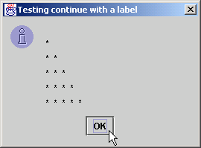
ContinueLabelTest.java
34 JOptionPane.showMessageDialog(
35 null, output,"Testing continue with a label",
36 JOptionPane.INFORMATION_MESSAGE );
37
38 System.exit( 0 ); // terminate application
39
40 } // end method main
41
42 } // end class ContinueLabelTest

Slide 79
Operadores Lógicos
Operan con valores true y false
  Permiten condiciones más complejas
  Combinan condiciones senciallas
En Java
  && (AND lógico → con corto circuito)
  & (AND booleano → sin corto circuito )
  || (OR lógico)
  | (OR booleano)
  ^ (XOR)
  ! (NOT lógico)

Slide 80
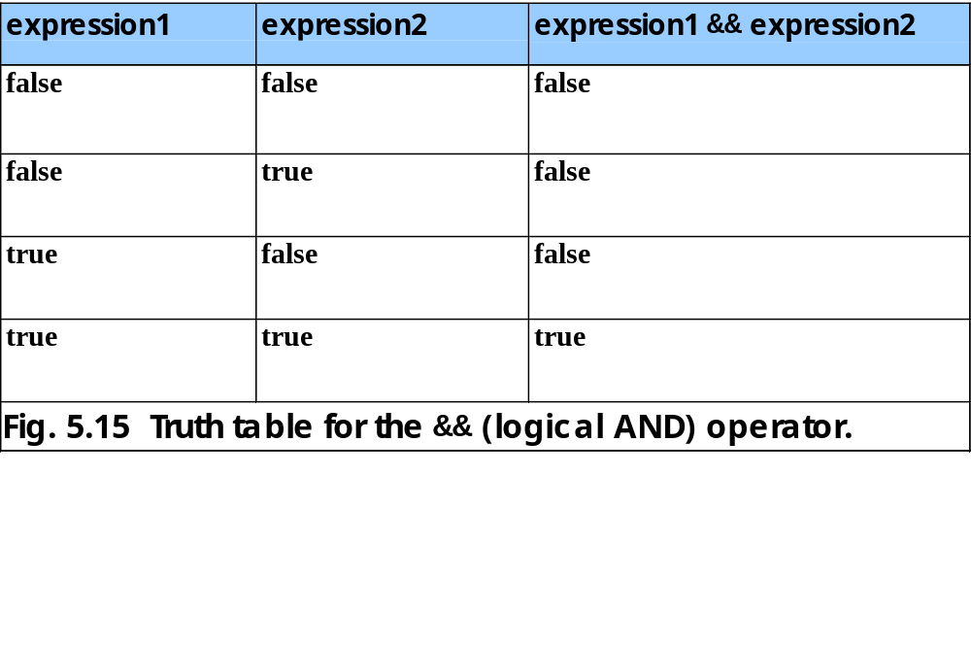

Slide 81
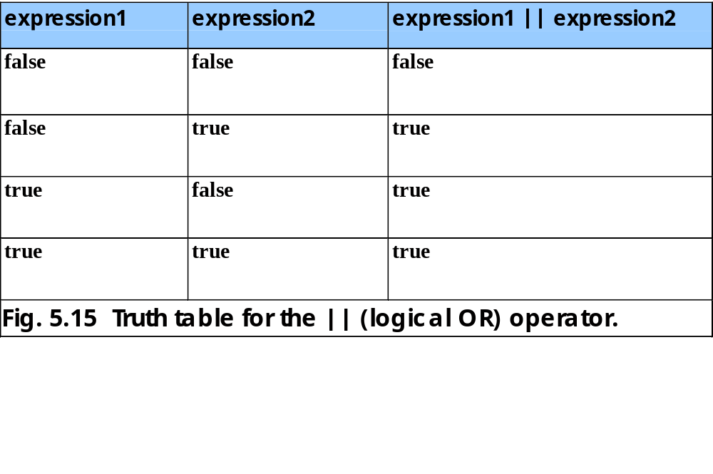

Slide 82
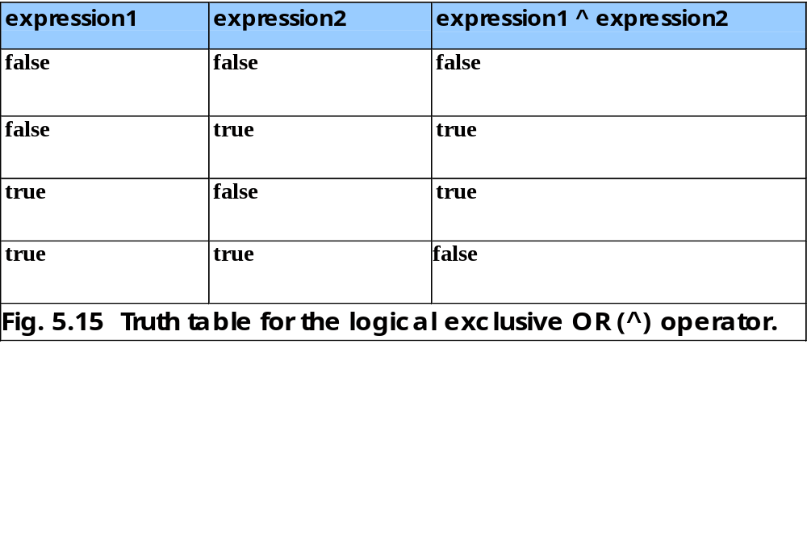

Slide 83
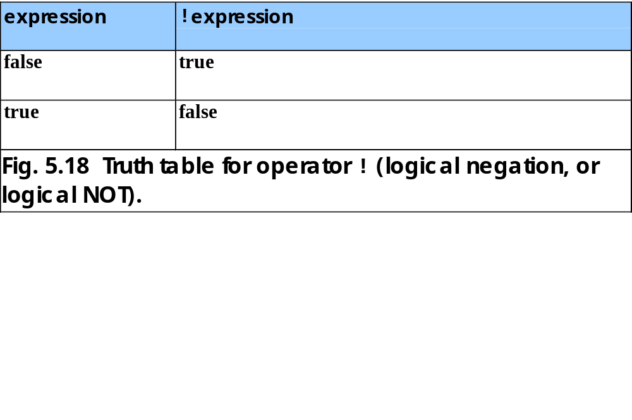

Slide 84
LogicalOperators.java
Lines 22-26
Lines 29-33
1 // Fig. 5.19: LogicalOperators.java
2 // Demonstrating the logical operators
3
4 // Java extension packages
5 import javax.swing.*;
6
7 public class LogicalOperators {
8
9 // main method begins execution of Java application
10 public static void main( String args[] )
11 {
12 // create JTextArea to display results
13 JTextArea outputArea = new JTextArea( 17, 20 );
14
15 // attach JTextArea to a JScrollPane so user can
16 // scroll through results
17 JScrollPane scroller = new JScrollPane( outputArea );
18
19 String output;
20
21 // create truth table for && operator
22 output = "Logical AND (&&)" +
23 "\nfalse && false: " + ( false && false ) +
24 "\nfalse && true: " + ( false && true ) +
25 "\ntrue && false: " + ( true && false ) +
26 "\ntrue && true: " + ( true && true );
27
28 // create truth table for || operator
29 output += "\n\nLogical OR (||)" +
30 "\nfalse || false: " + ( false || false ) +
31 "\nfalse || true: " + ( false || true ) +
32 "\ntrue || false: " + ( true || false ) +
33 "\ntrue || true: " + ( true || true );
34
Logical AND truth table
Logical OR truth table

Slide 85
LogicalOperators.java
Lines 36-40
Lines 43-47
Lines 50-54
Lines 57-59
35 // create truth table for & operator
36 output += "\n\nBoolean logical AND (&)" +
37 "\nfalse & false: " + ( false & false ) +
38 "\nfalse & true: " + ( false & true ) +
39 "\ntrue & false: " + ( true & false ) +
40 "\ntrue & true: " + ( true & true );
41
42 // create truth table for | operator
43 output += "\n\nBoolean logical inclusive OR (|)" +
44 "\nfalse | false: " + ( false | false ) +
45 "\nfalse | true: " + ( false | true ) +
46 "\ntrue | false: " + ( true | false ) +
47 "\ntrue | true: " + ( true | true );
48
49 // create truth table for ^ operator
50 output += "\n\nBoolean logical exclusive OR (^)" +
51 "\nfalse ^ false: " + ( false ^ false ) +
52 "\nfalse ^ true: " + ( false ^ true ) +
53 "\ntrue ^ false: " + ( true ^ false ) +
54 "\ntrue ^ true: " + ( true ^ true );
55
56 // create truth table for ! operator
57 output += "\n\nLogical NOT (!)" +
58 "\n!false: " + ( !false ) +
59 "\n!true: " + ( !true );
60
61 outputArea.setText( output ); // place results in JTextArea
62
63 JOptionPane.showMessageDialog( null, scroller,
64 "Truth Tables", JOptionPane.INFORMATION_MESSAGE );
65
66 System.exit( 0 ); // terminate application
Boolean logical AND truth table
Boolean logical inclusive OR truth table
Boolean logical exclusive OR truth table
Logical NOT truth table

Slide 86
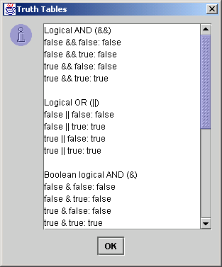
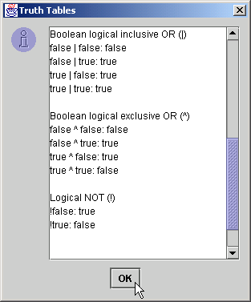
LogicalOperators.java
67
68 } // end method main
69
70 } // end class LogicalOperators

Slide 87
